Slide 1
DAB 103 Analytic Tools & Decision Making Team 5 - 002

Slide 2





Team Introduction
Zeelkumar Mendpara
Avikumar Patel
Sufyaan Junaidi
Rahulkumar Nasit
Ramya Theegala

Slide 3

Background/Motivation
There are many employees who get fired or they quit the jobs every month, and its difficult to maintain track of all employees who taken volunteer resignation.
For better retention and selecting new employees, it is important to know the characteristics and situations of the past ones, to make sure the company does not loose its employees.
This situation will give us motivation to take this as our project, in the end, we will try to provide useful insights and solutions to mitigate these issues so that the company can benefit.

Slide 4

Problem Statement
Any reputable company's HR department needs better insight into what types of employees were fired or resigned, and what characteristics to focus on in order to retain them.
Identifying the most significant reasons for experienced and young people dropping out, as they are more important for the company's development.

Slide 5

Project Proposal
Our project team will prepare a detailed analysis to examine the characteristics of the employees who resigned to help organizations find the best employee for a certain position and retain them.
By using EDA, Understanding the employee's existing condition and taking action to address controllable elements that can avoid employee turnover would be the key to success.

Slide 6
Analysis Questions
What are the top most characterises of the employees who volunteer resignation?
What are the top most departments and job role of the employees who volunteer resignation?
What number of employees were promoted and still taken volunteer resignation?
What are the employee source who volunteer resignation?
Find how much years employee work at company who volunteer resignation?
What is the performance rating of rating who volunteer resignation?
What is the average pay rate of employee who volunteer resignation?
What is the business travel type of employee who volunteer resignation?

Slide 7






Tools and libraries

Slide 8
Data Cleaning & Transformation
We have some outliers and missing value which can influence result so we did transformation and cleaning.
We drop some of the dataset.
We find mean or mode of respected column and replaces with missing value
For categorical data, we replace missing value with unknown.
We transform categorical data to numerical data using sklearn library.

Slide 9
Analysis Questions

Slide 10
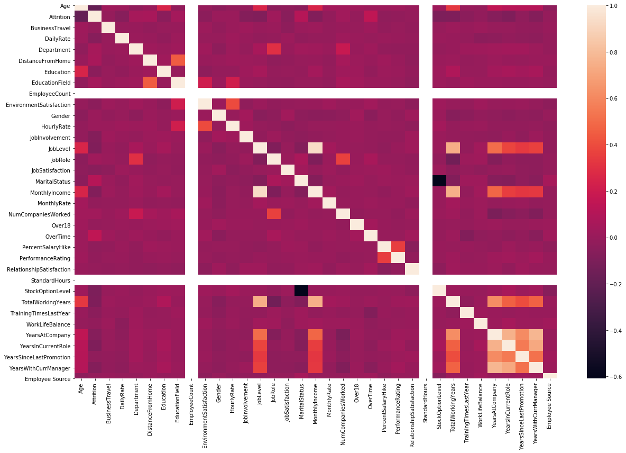
What are the top most characterizes of the employees who take volunteer resignation?

Slide 11
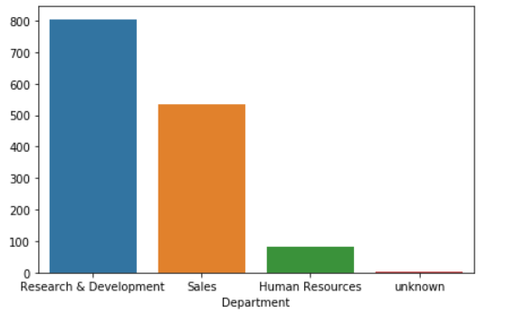
What are the top most departments of the employees who take volunteer resignation?

Slide 12
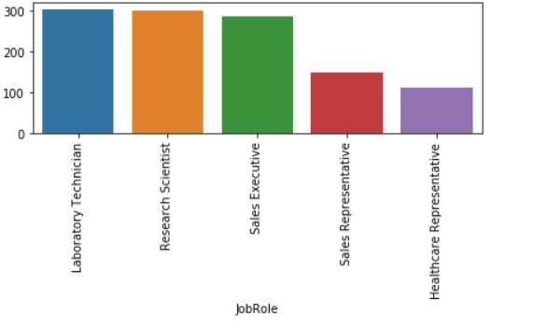
What are the top most job role of the employees who take volunteer resignation?

Slide 13
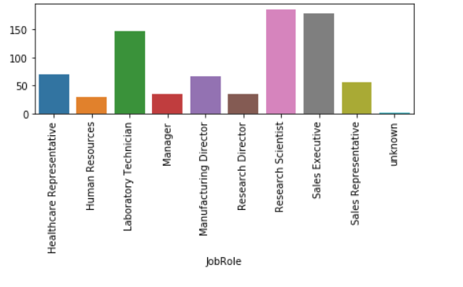
What number of employees were promoted and still take volunteer exit?

Slide 14
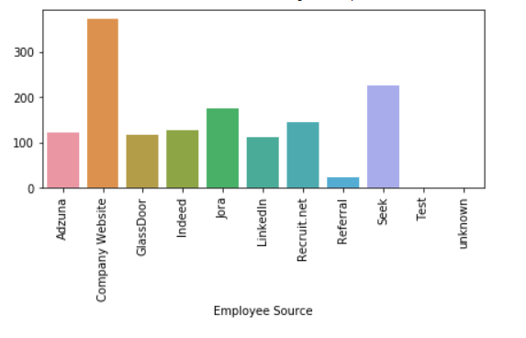
What are the employee source who have taken volunteer exit?

Slide 15
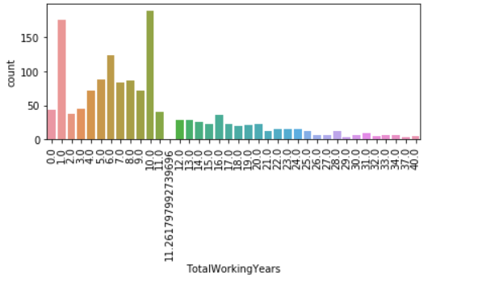
Find how much years employee work at company who have taken volunteer exit?

Slide 16
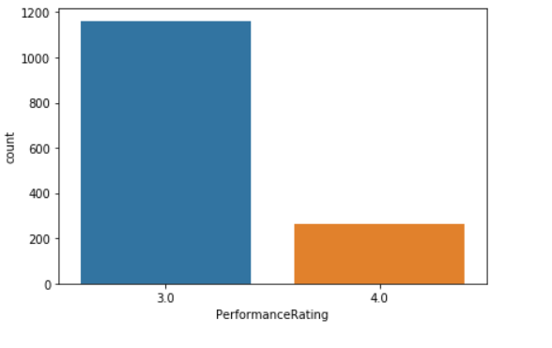
What is the performance rating of rating who got fired?

Slide 17
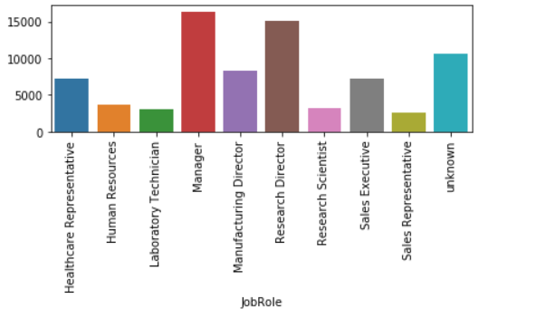
What is the average monthly income of employee who gave voluntary resignations?

Slide 18
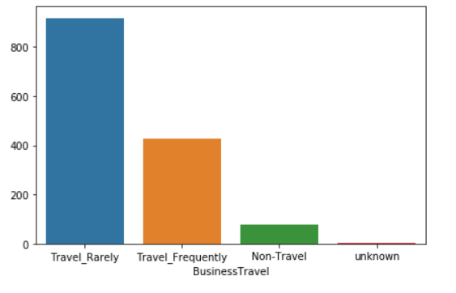
What is the business travel type of employee who gave voluntary resignations?

Slide 19
Conclusion
We have gone through different types of analysis, with different parameters. In conclusion, We would say that, the factors that affect most for the self resignation are Daily Rate, Education, Job involvement and level, Monthly Income, Stock option level and Total working experience.
Secondly, most of employee take resignation from Research and Development Department (These employees already got promotions) and whose main job role are Laboratory Technician, Research Scientist and Sales Executive.

Slide 20
Recommendations
We would like to recommend that while hiring employee for the any department below factors should be considered.
Daily Rate – Provide satisfactory so that employee can not leave.
Education – Employee education is suitable for the job.
Job involvement and level – How much employee need to involvement in his level of job
Monthly Income – Like daily rate
Total working experience – How much employee have experience for job. Does he/she will have enough experience.
By focusing these we can reduce the employee’s volunteer resignation.

Slide 21
Thank you !!

